Slide 1
Stochastic Calculus for Finance II
Chapter 4
財金所 潘政宏

Slide 2
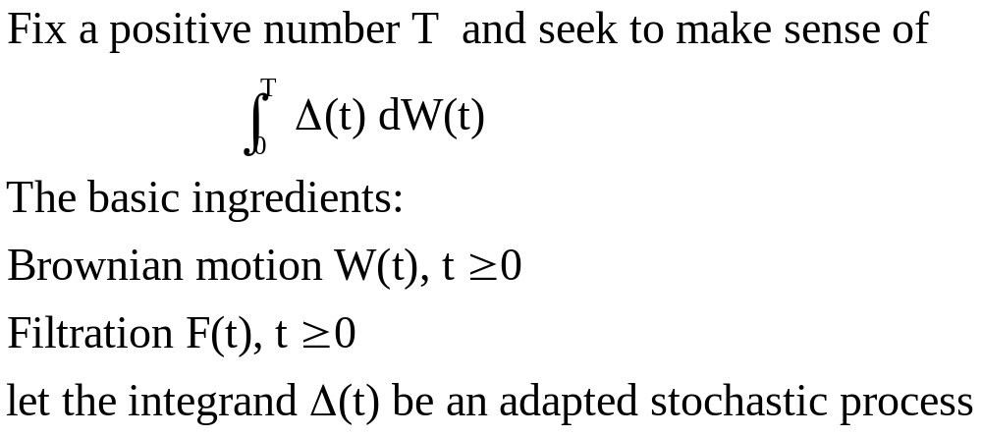
4.2 Ito’s Integral for Simple Integrands
(4.2.1)

Slide 3
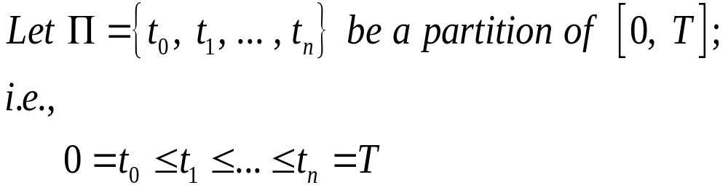
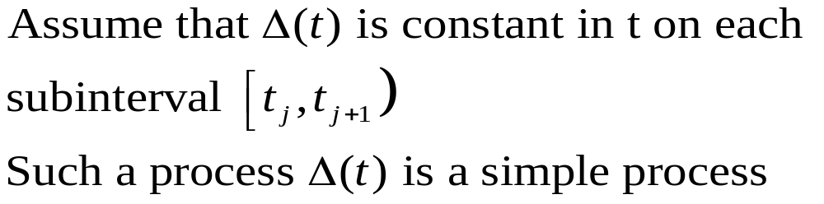

Slide 4
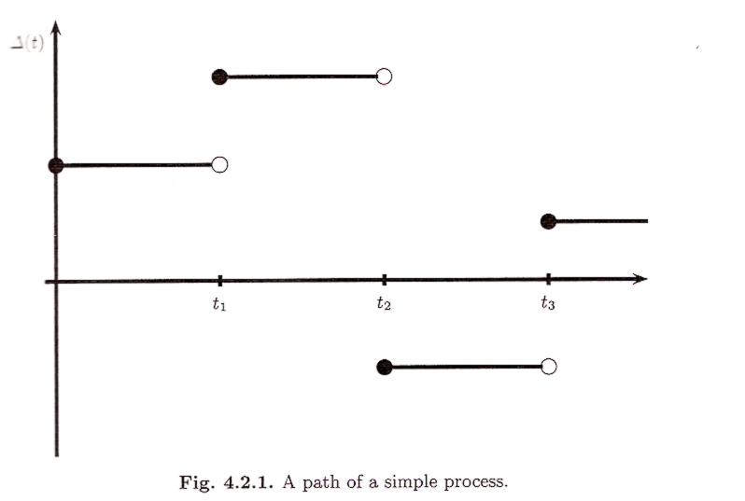

Slide 5
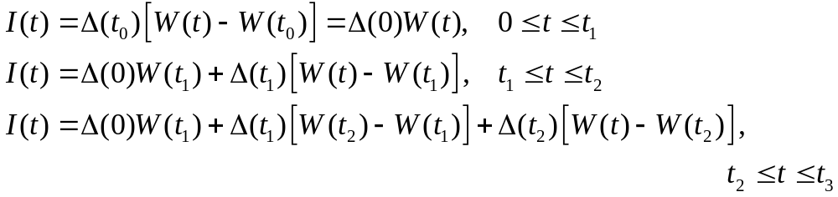
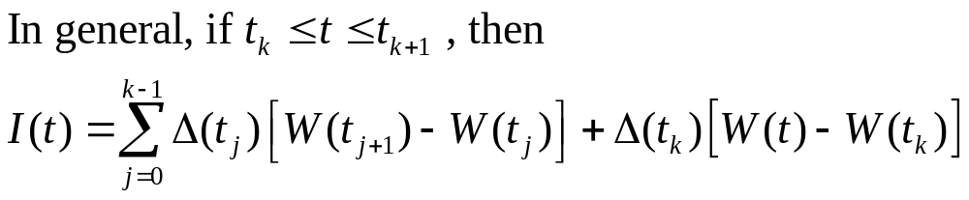
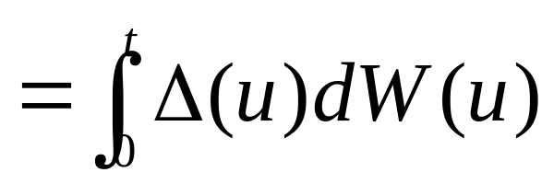
The gain from trading at each time t is given by
(4.2.2)

Slide 6
4.2.2 Properties of the Integral
Theorem 4.2.1
The Ito integral defined by (4.2.2) is a martingale.
i.e. E[I(t) | F(s) ]=I(s)

Slide 7
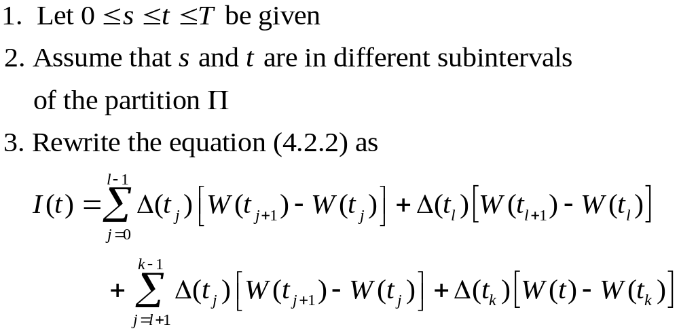
Proof
0 tl S tl+1 tk t tk+1 T

Slide 8
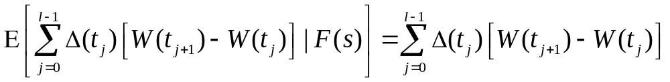
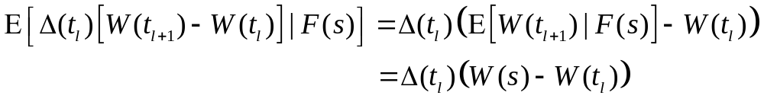

Slide 9
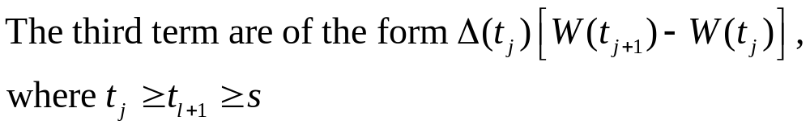
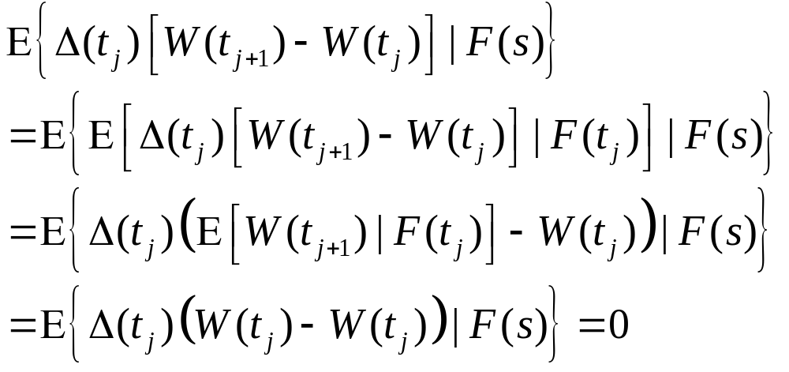
Tower Property:

Slide 10
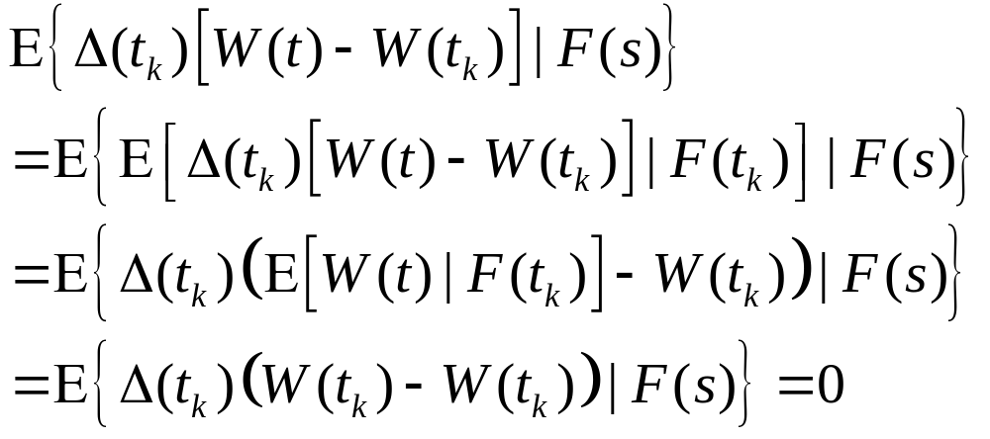

Slide 11
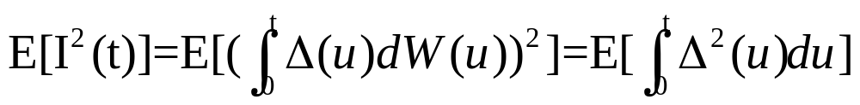
Theorem 4.2.2 Ito isometry
The Ito integral defined by (4.2.2) satisfies

Slide 12
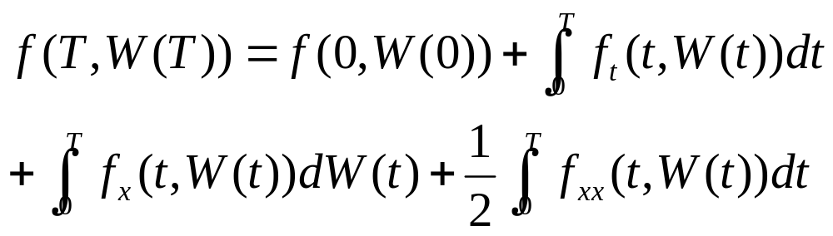
Ito formula
Thm 4.4.1
Let f(t,x) be a function for which the partial derivatives ft(t,x), fx(t,x), and fxx(t,x) are defined and continuous, and let W(t) be a Brownian motion.Then, for every T≧0,

Slide 13
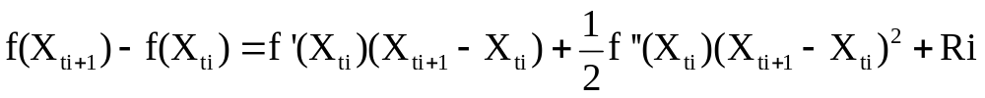

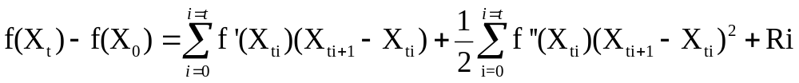
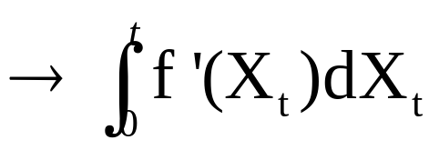
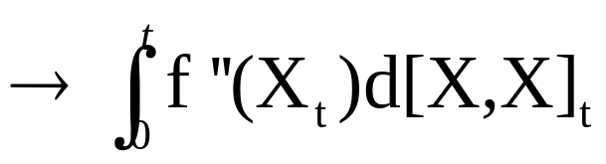

Sketch of proof:
By taylor expansion:

Slide 14
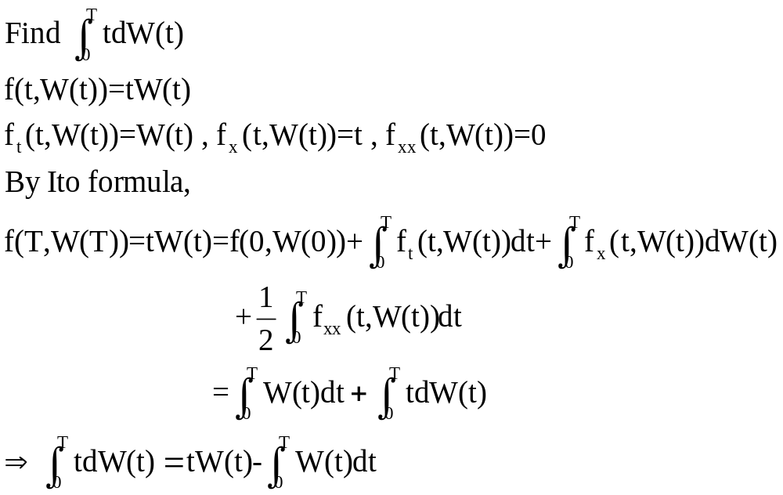
Example:

